Slide 1

David Gault | Sam Parent | Ali Zein | Arwa Abdulla | Amalia Jamaludin
2024
ECON 4011 - Monetary Economics | Professor Ilir Miteza
POLICY RECOMMENDATION
:)

Slide 2
David Gault, Sam Parent, Ali Zein, Arwa Abdulla, Amalia Jamaludin
2024
INTRODUCTION
ECONOMY TRENDS & NOW
GDP
LABOR MARKET
AD & AS
i = r + π
Trend
Components
Gap
Unemployment gap
Labor force
Trend
Job creation & wages
Sales & Inventories
GSCPI
Trend
Inflation expectation
Interest rate
MOMENTUM AND INDICATIOR
POLICY RECOMMENDATION
GDP
POLICY
LEI & CEI
INSIGHTS
FED ACTIONS
GDP
LEI & predicting economic trends
CEI & cycles
Trend
Components
Gap
Fiscal
Taylor Rule
Summary
Strategy
Tools
Trend
Components
Gap

Slide 3
David Gault, Sam Parent, Ali Zein, Arwa Abdullah, Amalia Jamaludin
2024
ECONOMY TRENDS & NOW
Data from Q3 2024
Data from November 2024
Data from October 2024
$23T
4.2%
2.80%
Real GDP Growth
Unemployment Rate
Inflation Rate
2.66% annual growth
Below NROU: ~ 0.01%
Target: 2%

Slide 4
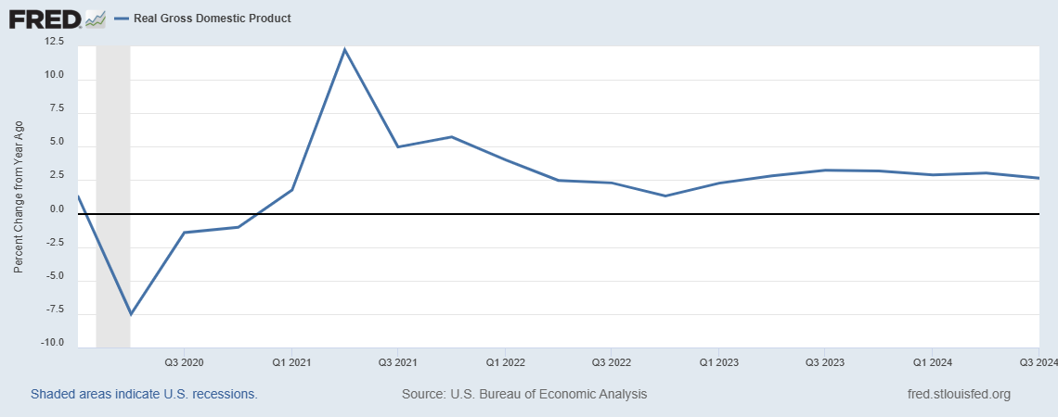
GDP TRENDS
2024
Rapid rebound in 2021, peaking significantly that aligns with the reopening of the economy, fiscal stimulus, and pent-up demand driving economic activity.
Q3 2024
2.66%
The stabilization around 2.5% reflects reduced growth momentum, signaling a moderation in economic activity due to high interest rates.
Steep drop in GDP growth in 2020 The GDP fell below 0%, due to widespread economic disruptions, lockdowns, and reduced economic activity.

Slide 5
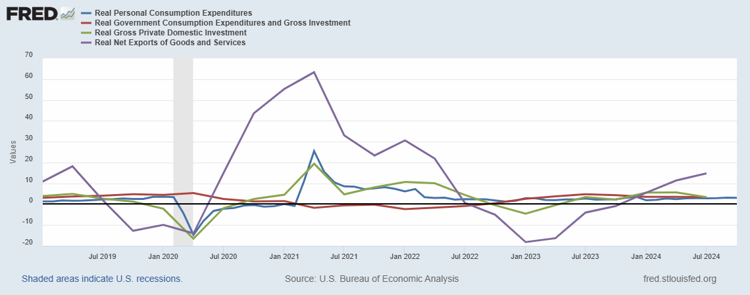
GDP COMPONENTS
The contributions to GDP by its components for Q3
2024
Consumption (C): ~ 68.73%
Investment (I): ~ 16.95%
Government Spending (G): ~ 18.73%
Net Exports (X - IM): ~ -4.61%
Largest driver of economic activity, reflecting strong household spending despite inflationary pressures.
As of 2024, GDP components growth reflects an economy moving toward moderation, characterized by steady but slower growth dynamics
Q3 2024
2.82%
3.35%
3.39%
14.77%

Slide 6
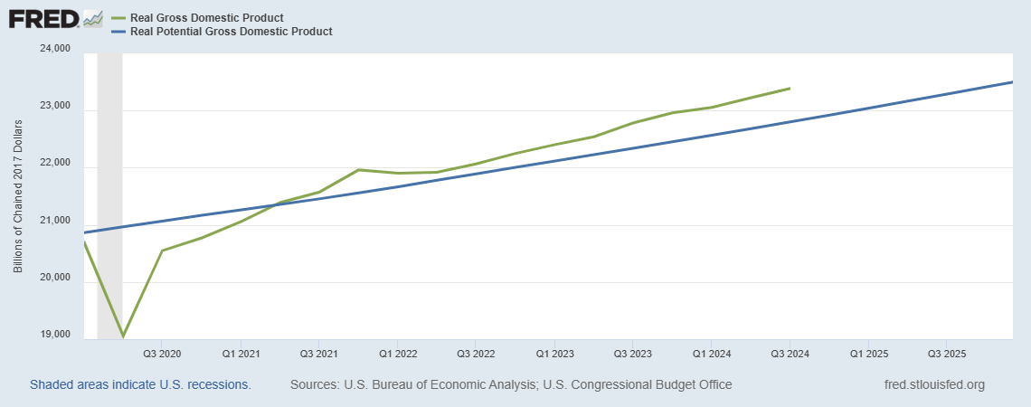
GDP GAP
2024
According to GDPNow, the U.S. economy is expected to grow by 3.29%
(A bit above average. 2% - 3% is consider good) in the fourth quarter of 2024. This means the economy is growing at a strong pace.
Real GDP > Potential GDP
May not be sustainable long-term, potentially causing:
inflation
higher interest rates
market corrections.
BUT the interest rates cut due to cooling inflation, a softening (yet strong) labor market, and the need to stabilize growth amidst uncertainties, focusing on managing risks over high GDP

Slide 7
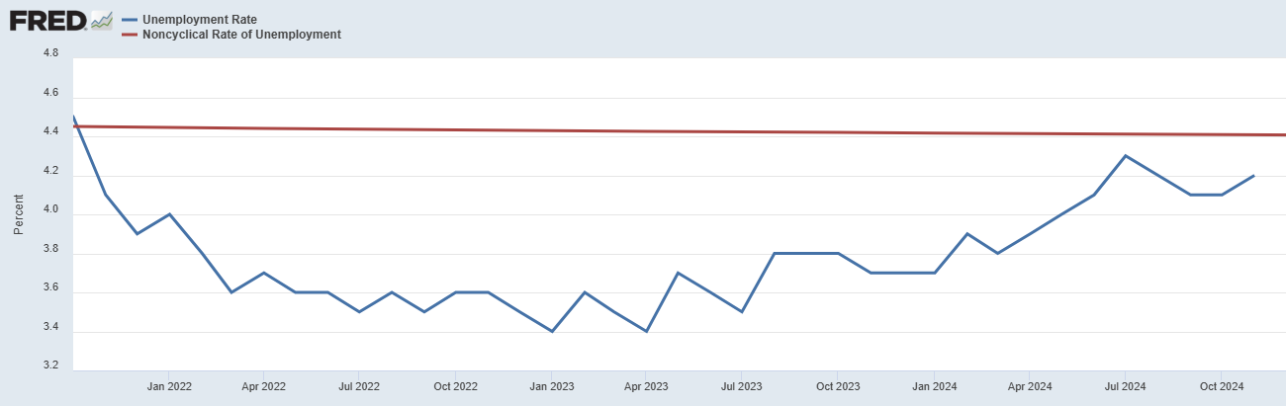
UNEMPLOYMENT GAP
2024
Unemployment rate remained below the NAIRU, signaling a tight labor market.
Unemployment has been approaching the NAIRU
Indicates that the labor market is losing some of its earlier tightness, which reduces upward pressure on wages and inflation.
2024
Insights
While unemployment remains low, job losses are concentrated in sectors like manufacturing, warehousing, and information technology, driven by factors like reduced consumer demand, global supply chain issues, and post-pandemic adjustments like construction and healthcare continue to show resilience with strong growth. Temporary disruptions, such as hurricanes and strikes, have also influenced employment trends in certain regions .
Notes:
Behind the Aggregate Data (November 2024):
While aggregate unemployment remains low at 4.1%, important details emerge upon examining sector-specific trends. The job market shows a mix of resilience and weakness, with impacts concentrated in certain areas rather than being broad-based.
Key Insights:
Concentrated Weakness in Specific Sectors:
Manufacturing and Warehousing: These sectors saw job losses in October 2024, reflecting broader challenges like reduced consumer demand, global supply chain issues, and rising borrowing costs【25†source】【26†source】.
Information Technology: Layoffs in tech have persisted due to cost-cutting and post-pandemic corrections in hiring, though the pace has slowed compared to 2023【26†source】.
Resilient Sectors:
Construction: Despite higher interest rates dampening demand for new projects, construction added jobs in October, growing 2.8% year-over-year due to strong demand for infrastructure projects【26†source】.
Healthcare and Services: These industries continue to expand steadily, driven by population growth and increasing demand for healthcare services【25†source】.
Labor Force Participation and Wage Growth:
Labor force participation remained stable around 62.6%, though slightly below pre-pandemic levels. Wage growth, especially in lower-paying sectors like leisure and hospitality, has moderated but remains higher than pre-pandemic averages【26†source】.
Regional and Demographic Variations:
Hurricane Impacts: Severe weather in October 2024 disrupted employment in several states, temporarily reducing job availability【26†source】.
Strikes: Labor actions in industries like automotive manufacturing contributed to temporary employment declines but also highlighted worker bargaining power【25†source】【27†source】.
Is Unemployment Broad-Based?
Unemployment is not broad-based but rather concentrated in specific industries and regions. Certain sectors—especially manufacturing, warehousing, and tech—are under strain, while healthcare, construction, and leisure show resilience. This divergence underscores the uneven recovery and sector-specific challenges facing the U.S. economy.
"US Employment Situation Report for October 2024." U.S. Bureau of Labor Statistics, 3 Nov. 2024, www.bls.gov/news.release/empsit.nr0.htm. Accessed 5 Dec. 2024.
Rugaber, Christopher. "US Employers Add Just 12,000 Jobs in October as Strikes and Weather Hurt Hiring." Associated Press News, 3 Nov. 2024, apnews.com/article/us-employment-october-2024-trends. Accessed 5 Dec. 2024.
Scheiber, Noam. "Unions and Labor Market Dynamics: Lessons from 2024." The New York Times, 3 Nov. 2024, www.nytimes.com/2024/11/03/business/economy/us-labor-market.html. Accessed 5 Dec. 2024.
"United States Employment Report – November 2024 Trends." Trading Economics, Nov. 2024, tradingeconomics.com/united-states/employment-data. Accessed 5 Dec. 2024.
"United States: Employment – 2024 Highlights and 2025 Outlook." Mayer Brown, Nov. 2024, www.mayerbrown.com/en/perspectives-events/publications/2024/us-employment-trends. Accessed 5 Dec. 2024

Slide 8
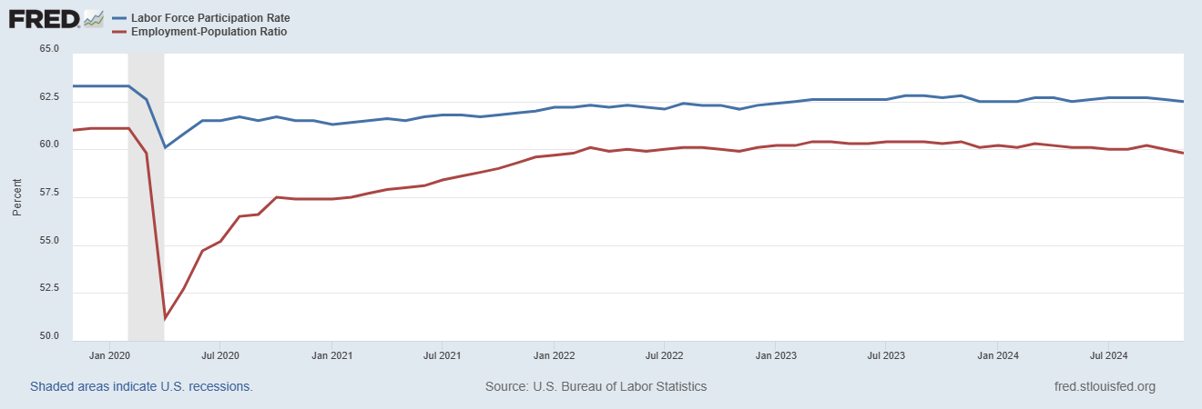
LABOR FORCE
2024
Labor force participation is steady but still below pre-pandemic levels.
Declines slightly toward the end, suggesting a softening labor market where fewer people are employed relative to the working-age population.
Both indicators began to recover at different rates: LFPR has small increased and remained relatively flat, indicating some workers left the labor force entirely
EPR increased more quickly as people regained jobs.

Slide 9
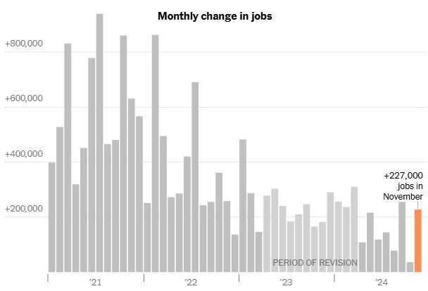
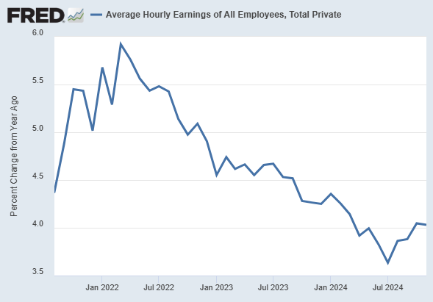
JOB CREATION & WAGES
2024
In November 2024, job growth remained strong with 227,000 jobs added, but still within the last year range. The job creations signaling modest expansion despite disruptions like strikes and hurricanes. This continued job creation reflects a cooling labor market compared to the rapid growth seen in 2021.
Wage growth, driven by cost-push inflation, has moderated due to our rate hikes but remains elevated. Over the past year, it slowed from 4.5% to 3.7% in early 2024, then rose slightly above 4%. While closer to pre-pandemic levels, wage growth is still fast, reflecting labor market tightness.
Notes:
Slide Title: Labor Market and Inflation Dynamics in 2024
"Good [morning/afternoon], everyone. Today, I’ll explore how the labor market in 2024 has influenced inflation and economic stability. This topic is crucial as policymakers strive to balance economic growth with price stability.
Let’s start with wage growth, a key indicator of labor market tightness and a driver of cost-push inflation. Over the past year, wage growth slowed from 4.5% to 3.7% by early 2024. However, it rose slightly above 4%, which remains elevated by historical standards. While this is closer to pre-pandemic levels, it highlights that wage pressures persist, partly due to strong labor demand. Elevated wage growth, while beneficial for workers, complicates efforts to control inflation.
Next is job creation, which remains robust despite some disruptions, including strikes and hurricanes. In November 2024 alone, 227,000 jobs were added. While this is impressive, it’s a moderation compared to the rapid job recovery we saw in 2021. This cooling indicates a gradual normalization of the labor market as the economy stabilizes post-pandemic.
Consumer Confidence Index (CCI):
Increased to 111.7 in November, up from 109.6 in October.
This improvement was largely driven by better perceptions of the labor market and moderate optimism about future conditions​ The Conference Board .
Present Situation Index:
Rose by 4.8 points to 140.9, showing improved assessments of current business and labor market conditions.
Consumers reporting jobs as "hard to get" decreased, and those finding jobs "plentiful" remained relatively high​ The Conference Board .
Expectations Index:
Increased slightly to 92.3, well above the recession-indicating threshold of 80.
Optimism for job availability reached its highest level in nearly three years, but expectations for income and business conditions showed little change​ The Conference Board .
Labor Market and Income Expectations:
21.7% of respondents anticipated more jobs being available in six months, an increase from October.
Income expectations were steady, with 19% expecting increases, though this marked a slight decline from October​ The Conference Board .
Inflation and Economic Concerns:
Inflation expectations for the next 12 months declined to 4.9%, the lowest since March 2020.
Concerns about higher prices persist, topping consumers’ lists for 2025 alongside taxes, social unrest, and financial stability​ The Conference Board .
Implications:
The improvement in consumer confidence reflects a more positive sentiment toward labor market conditions and moderated inflation concerns. However, challenges such as elevated prices and cautious income expectations remain. This data suggests resilience in consumer spending heading into 2025, though external economic pressures could still affect overall sentiment.

Slide 10
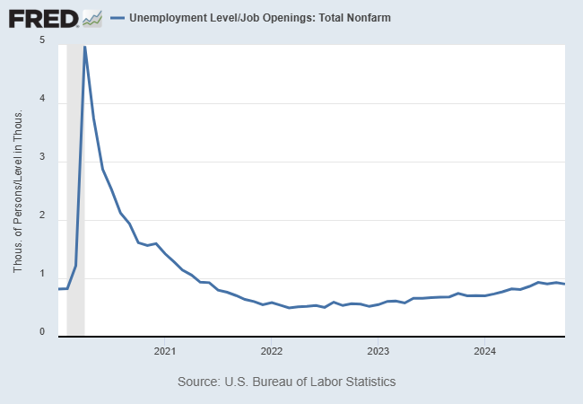
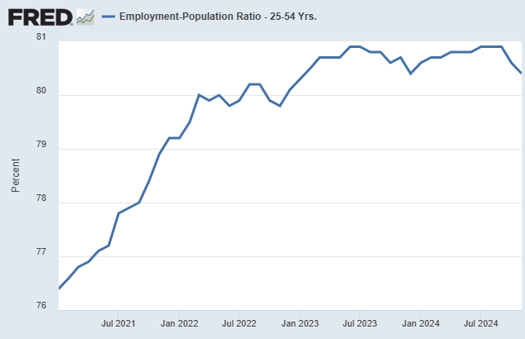
LABOR MARKET
2024
The ratio fell below 1 in 2021, meaning job openings exceeded unemployed people, signaling an exceptionally tight labor market. It later rose to nearly 1, showing a slight balance shift but still reflecting a strong labor market.
The ratio rose steadily after 2021, peaking near 81%, showing strong labor demand. Recently, it has slightly declined, indicating a modest cooling in employment levels, though the labor market remains healthy.
The labor market remains tight but shows signs of stabilizing or softening slightly.
This could ease wage pressures and support efforts to bring inflation under control
Notes:
A critical metric here is the labor market ratio, which measures the balance between job openings and unemployed individuals. This ratio peaked near 81% after 2021, signaling an exceptionally tight labor market. Recently, it has declined slightly, showing signs of a modest cooling. However, it remains strong, indicating continued labor market health. Importantly, a softening labor market can help reduce wage pressures, aligning with broader efforts to control inflation.
Consumer Confidence Index (CCI):
Increased to 111.7 in November, up from 109.6 in October.
This improvement was largely driven by better perceptions of the labor market and moderate optimism about future conditions​ The Conference Board .
Present Situation Index:
Rose by 4.8 points to 140.9, showing improved assessments of current business and labor market conditions.
Consumers reporting jobs as "hard to get" decreased, and those finding jobs "plentiful" remained relatively high​ The Conference Board .
Expectations Index:
Increased slightly to 92.3, well above the recession-indicating threshold of 80.
Optimism for job availability reached its highest level in nearly three years, but expectations for income and business conditions showed little change​ The Conference Board .
Labor Market and Income Expectations:
21.7% of respondents anticipated more jobs being available in six months, an increase from October.
Income expectations were steady, with 19% expecting increases, though this marked a slight decline from October​ The Conference Board .
Inflation and Economic Concerns:
Inflation expectations for the next 12 months declined to 4.9%, the lowest since March 2020.
Concerns about higher prices persist, topping consumers’ lists for 2025 alongside taxes, social unrest, and financial stability​ The Conference Board .
Implications:
The improvement in consumer confidence reflects a more positive sentiment toward labor market conditions and moderated inflation concerns. However, challenges such as elevated prices and cautious income expectations remain. This data suggests resilience in consumer spending heading into 2025, though external economic pressures could still affect overall sentiment.

Slide 11
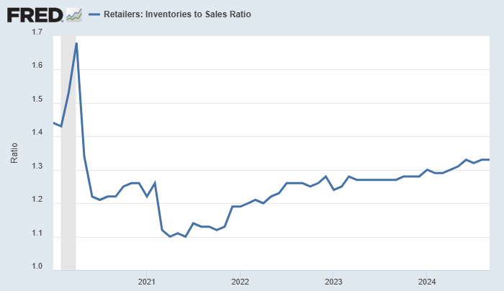
SUPPLY SIDE
2024
Compared to the last year, the trend shows an increase in the inventories to sales ratio after a sharp drop in 2020 that signals supply shortage.
A ratio of 1.33 in September 2024 suggests retailers may be holding more inventory, potentially leading to discounting to clear excess stock, which can help ease inflation. We can see it showing moderate increasing trend but still within 1.3 - 1.5 typical range in US economy.
Notes:
Now, turning to the supply side, inventory-to-sales ratios have improved, moving toward normal levels after a sharp drop in 2020 that reflected supply shortages. As of September 2024, a ratio of 1.33 suggests that retailers are holding more inventory. This could lead to discounting, which may ease inflationary pressures.

Slide 12
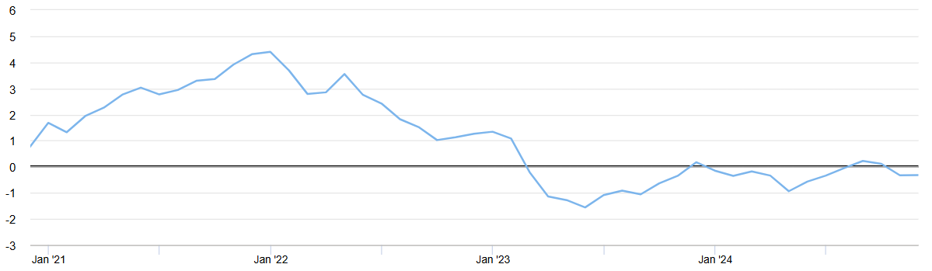
Global Supply Chain Pressure Index
2024
Supply chain (cost-push inflationary) pressures gradually eased as
transportation costs declined, and production improved.
November this year
-0.33
The index fluctuated around the baseline, suggesting near-normal conditions with occasional, mild disruptions. Supply chain costs are stable, reducing the likelihood of further inflationary spikes.
The GSCPI dropped into negative territory in 2023, indicating that global supply chain conditions became better than average, reflecting stable logistics and reduced disruptions.
Notes:
The GSCPI is carefully constructed to isolate supply-side pressures from demand influences by adjusting PMI and transport cost variables, handling data gaps through PCA, and revising readings as updated data become available.
Lastly, on the global front, supply chain pressures have significantly eased. The Global Supply Chain Pressure Index, or GSCPI, dropped into negative territory in 2023 and remained there in 2024. This indicates that supply chain conditions are better than average, thanks to declining transportation costs and improved production. Stable supply chains reduce the risk of cost-push inflation, providing further relief to the broader economy.
Key Takeaways: While the labor market shows signs of cooling, it remains tight enough to sustain wage growth. Combined with improving supply-side conditions, these trends offer cautious optimism. However, balancing labor market health with inflation control remains a key challenge for policymakers.
1. "Do you think the current monetary policy stance—lowering interest rates—will be enough to balance inflation and labor market dynamics?"
Response:
Lowering interest rates stimulates economic activity by encouraging borrowing and spending, which could boost job creation. However, it might also reignite inflationary pressures, especially if wage growth remains strong due to a tight labor market.
The success of this policy depends on how quickly labor market tightness eases. If job openings and wage growth stabilize, lowering rates might support a balanced recovery.
You could point out the risk of acting too early, as prematurely lowering rates might prolong inflation rather than help achieve the desired equilibrium.
Example Conclusion:
"Ultimately, while rate reductions can help stabilize growth, they need to be timed carefully to avoid reintroducing inflationary pressures, especially if the labor market remains tight."
2. "How might global supply chain stability impact domestic wage growth trends in the coming years?"
Response:
A stable global supply chain reduces production and transportation costs, lowering the prices of goods and services. This could reduce inflationary pressures, which in turn might alleviate the need for workers to demand higher wages to keep up with rising living costs.
However, wage growth is not solely driven by supply chain factors—it’s also influenced by domestic labor market conditions. If demand for workers remains high relative to supply, wages are likely to remain elevated even with stable supply chains.
Additionally, as supply chain conditions stabilize, companies may shift their focus back to investing in productivity improvements, potentially reducing the reliance on labor-intensive solutions.
Example Conclusion:
"While supply chain stability can indirectly ease wage pressures by containing inflation, domestic labor market dynamics will likely remain the primary driver of wage growth trends."

Slide 13
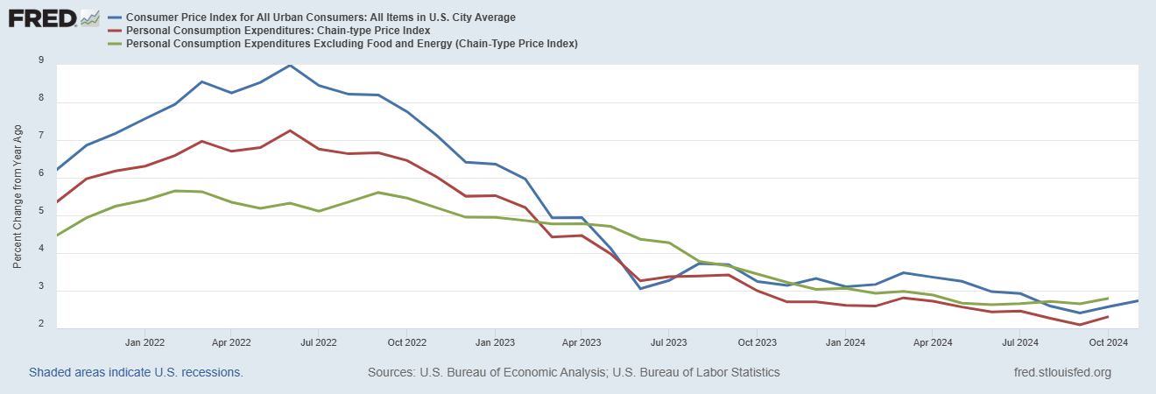
INFLATION
2024
September this year
2.41%
2.10%
2.65%
October this year
2.58%
2.31%
2.80%
i = r + π
# Interest rates at 5.25% to 5.50% from July 2023 to September 2024.
Notes:
https://www.usbank.com/investing/financial-perspectives/market-news/federal-reserve-tapering-asset-purchases.html#:~:text=The%20Fed%20held%20rates%20at,Reserve%2C%20November%207%2C%202024.
CPI measures the overall cost of goods and services purchased by urban consumers, reflecting headline inflation.
Measures the prices of a fixed basket of goods and services bought by urban consumers.
Focuses on out-of-pocket costs like rent, groceries, and transportation.
Doesn't account for consumers switching to cheaper alternatives.
PCE is a broader measure of inflation preferred by the Federal Reserve, capturing changes in consumer spending patterns.
Measures the prices of all goods and services households consume, including indirect costs (e.g., employer-paid health insurance).
Adjusts for changes in what consumers buy (substitution effect).
Covers a broader range of spending than CPI.
Core PCE index excluding volatile food and energy prices, used to measure underlying inflation trends.
Same as PCE but excludes food and energy prices, which are more volatile.
Provides a more stable measure of underlying inflation trends.

Slide 14
INFLATION
2024
In 2022, CPI surged to a multi-decade high, exceeding 8% year-over-year, driven by supply chain disruptions, energy price spikes, and stimulus-fueled demand.
Inflation began easing in 2023 due to our interest rate hikes, improved supply chains, and cooling energy prices. By late 2023 and 2024, CPI inflation fell closer to 3%.
The PCE closely mirrored CPI trends but generally reported slightly lower inflation rates, reflecting its broader scope and methodology.
Like CPI, the PCE peaked in 2022 but started declining steadily in 2023 as the economy responded to tightening monetary policy.
Core PCE rose less sharply than headline CPI or PCE during the inflation spike, as it excludes volatile energy and food prices.
It remained more stable but still elevated above the 2% target. By 2024, Core PCE moderated gradually, indicating a slowdown in structural inflationary pressures. Despite headline improvements, inflation in services and housing continues to lag behind for October .
Notes:
https://www.usbank.com/investing/financial-perspectives/market-news/federal-reserve-tapering-asset-purchases.html#:~:text=The%20Fed%20held%20rates%20at,Reserve%2C%20November%207%2C%202024.
CPI measures the overall cost of goods and services purchased by urban consumers, reflecting headline inflation.
Measures the prices of a fixed basket of goods and services bought by urban consumers.
Focuses on out-of-pocket costs like rent, groceries, and transportation.
Doesn't account for consumers switching to cheaper alternatives.
PCE is a broader measure of inflation preferred by the Federal Reserve, capturing changes in consumer spending patterns.
Measures the prices of all goods and services households consume, including indirect costs (e.g., employer-paid health insurance).
Adjusts for changes in what consumers buy (substitution effect).
Covers a broader range of spending than CPI.
Core PCE index excluding volatile food and energy prices, used to measure underlying inflation trends.
Same as PCE but excludes food and energy prices, which are more volatile.
Provides a more stable measure of underlying inflation trends.

Slide 15
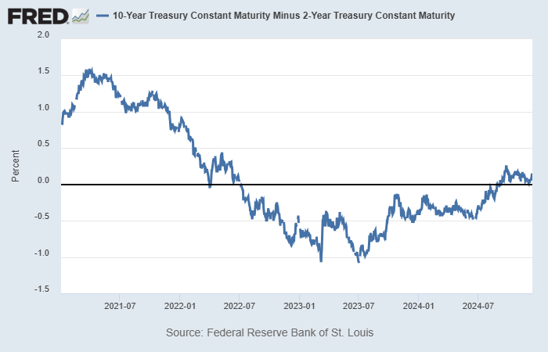
INTEREST RATE
i = r + π
2024
It highlights significant changes in market sentiment. As we rapidly hiked short-term rates to fight inflation in 2022, the spread became dramatically negative, indicating an inverted yield curve, a well-known indicator of recessions. The flatness of the curve still indicates economic uncertainty and cautious market expectations about future growth, even though the recent rebound towards zero implies that recession concerns are abating.
2022 Inversion:
Rising Recession Risk
2024 Rebound: Moderating Concerns
It’s important to continue monitoring the yield curve closely.
A sustained steepening would indicate improving economic confidence and growth expectations that could overheating the economy. However, a prolonged flat
or reinverted curve would reinforce caution regarding potential slowdown.
Notes:
https://apnews.com/article/federal-reserve-inflation-interest-rate-economy-7e0405851b6099278d491d0a938238f5
Summary: Christopher Waller, a member of the Federal Reserve's Board of Governors, signaled support for a quarter-point rate cut at the December meeting, provided incoming data did not reveal unexpected inflationary pressures. While confident in a gradual decline in inflation, Waller acknowledged risks of it stalling above the Fed's 2% target. Mixed signals from the economy, including robust consumer spending and economic growth in the July-September quarter alongside a slight uptick in core inflation from 2.7% to 2.8% in October, underscored the need for caution. The Fed, already having cut rates by 0.75% this year, faced persistent inflation challenges that complicated further easing. Waller and other Fed officials, such as Atlanta Fed President Raphael Bostic, emphasized a data-dependent approach, reflecting the Fed’s cautious and flexible strategy in navigating economic uncertainty.
Analysis: The Fed was monitoring core inflation (notably its slight uptick from 2.7% in September to 2.8% in October), consumer spending trends, and economic growth data before its December meeting to determine if inflation was continuing to decline or stalling above the 2% target. These indicators would inform whether to cut rates or hold steady, as persistent inflation would argue against easing policy. Ultimately, the Fed implemented a quarter-point rate cut in December, consistent with Christopher Waller's remarks that easing monetary policy was likely unless incoming data surprised to the upside. The decision aligned with evidence of a still-restrictive policy stance that allowed for gradual rate reductions without reigniting inflation.

Slide 16
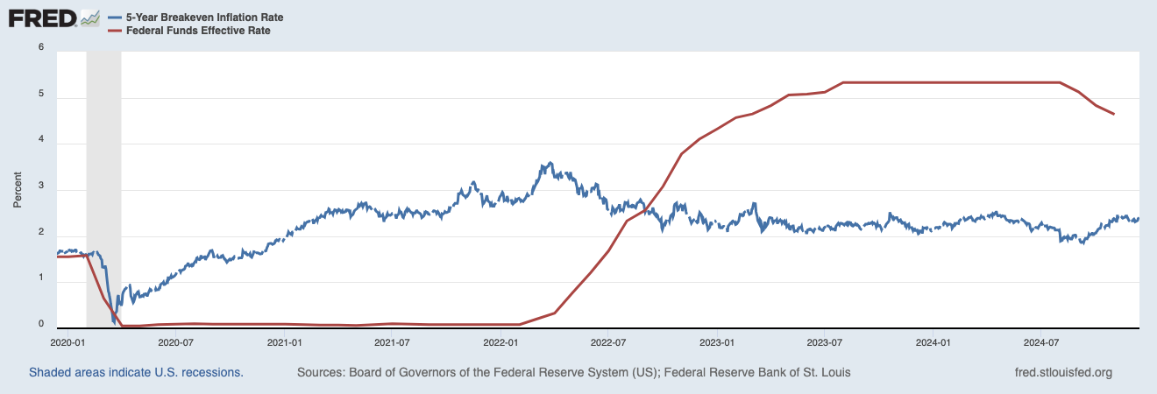
INTEREST RATE &
INFLATION EXPECTATIONS
2024
Suggests a shift to easing monetary policy
i = r + π
5.33% FFR
vs
4.64% FFR
Aggressive tightening addressed inflation risks but increased recession concerns.
Rate cuts amid an economic slowdown, despite ongoing inflation, aim to stimulate growth and avoid a recession. A softening economy may prioritize economic activity over controlling inflation, hoping that lower interest rates will encourage investment and spending.
Notes:
https://apnews.com/article/federal-reserve-inflation-interest-rate-economy-7e0405851b6099278d491d0a938238f5
Summary: Christopher Waller, a member of the Federal Reserve's Board of Governors, signaled support for a quarter-point rate cut at the December meeting, provided incoming data did not reveal unexpected inflationary pressures. While confident in a gradual decline in inflation, Waller acknowledged risks of it stalling above the Fed's 2% target. Mixed signals from the economy, including robust consumer spending and economic growth in the July-September quarter alongside a slight uptick in core inflation from 2.7% to 2.8% in October, underscored the need for caution. The Fed, already having cut rates by 0.75% this year, faced persistent inflation challenges that complicated further easing. Waller and other Fed officials, such as Atlanta Fed President Raphael Bostic, emphasized a data-dependent approach, reflecting the Fed’s cautious and flexible strategy in navigating economic uncertainty.
Analysis: The Fed was monitoring core inflation (notably its slight uptick from 2.7% in September to 2.8% in October), consumer spending trends, and economic growth data before its December meeting to determine if inflation was continuing to decline or stalling above the 2% target. These indicators would inform whether to cut rates or hold steady, as persistent inflation would argue against easing policy. Ultimately, the Fed implemented a quarter-point rate cut in December, consistent with Christopher Waller's remarks that easing monetary policy was likely unless incoming data surprised to the upside. The decision aligned with evidence of a still-restrictive policy stance that allowed for gradual rate reductions without reigniting inflation.

Slide 17
David Gault, Sam Parent, Ali Zein, Arwa Abdulla, Amalia Jamaludin
2024
MOMENTUM
AND
INDICATORS

Slide 18
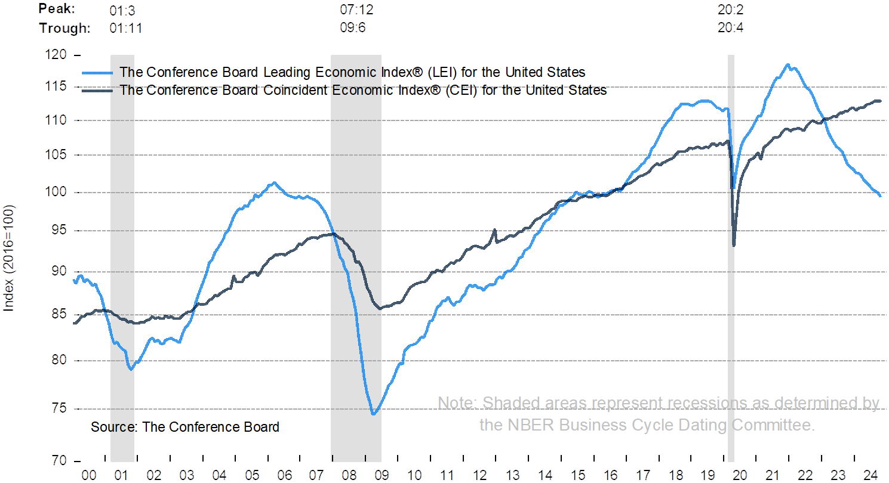
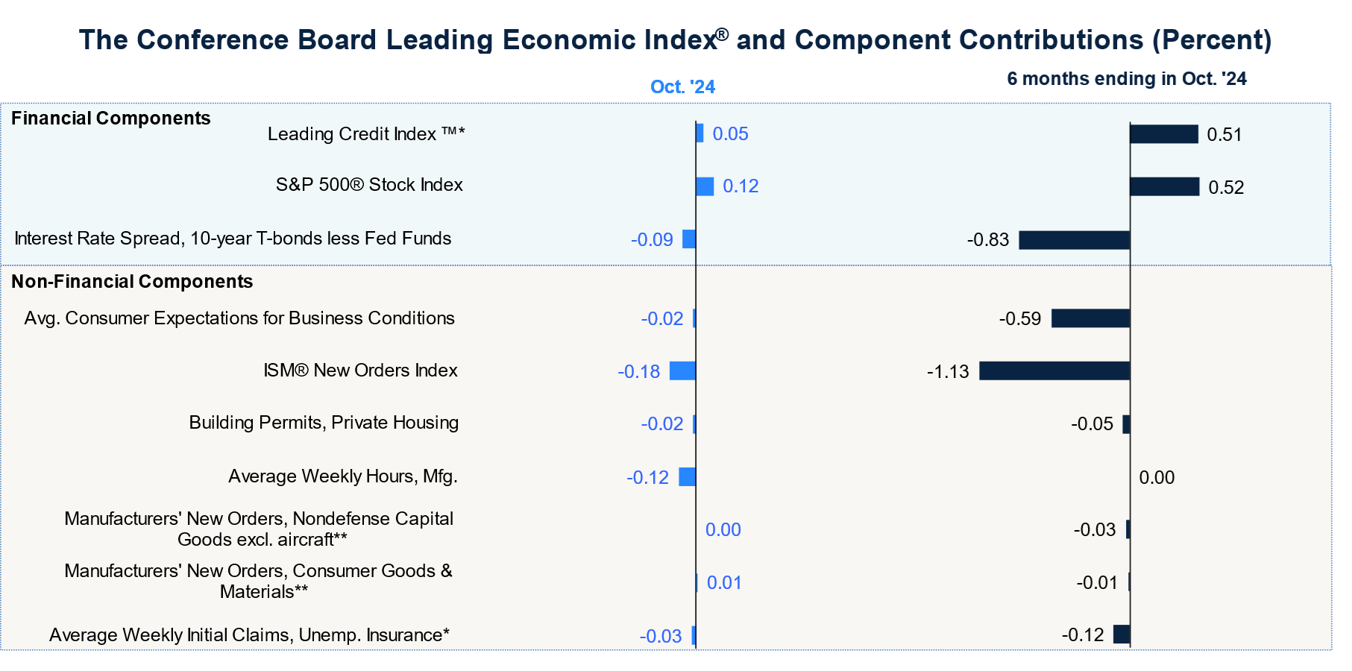
Recent: As of October 2024
2024
During the past six months, the Leading Economic Index has fallen by 2.2%, the leading negative contributor to this decrease being a lack of orders for nondefense capital goods. (excluding aircraft) The orders were weak in 11/14 industries. Further factors have also seen negative impacts, likely due to the hurricanes affecting the SouthEastern U.S.. The LEI overall is suggesting future hardship for the US economy.

Slide 19
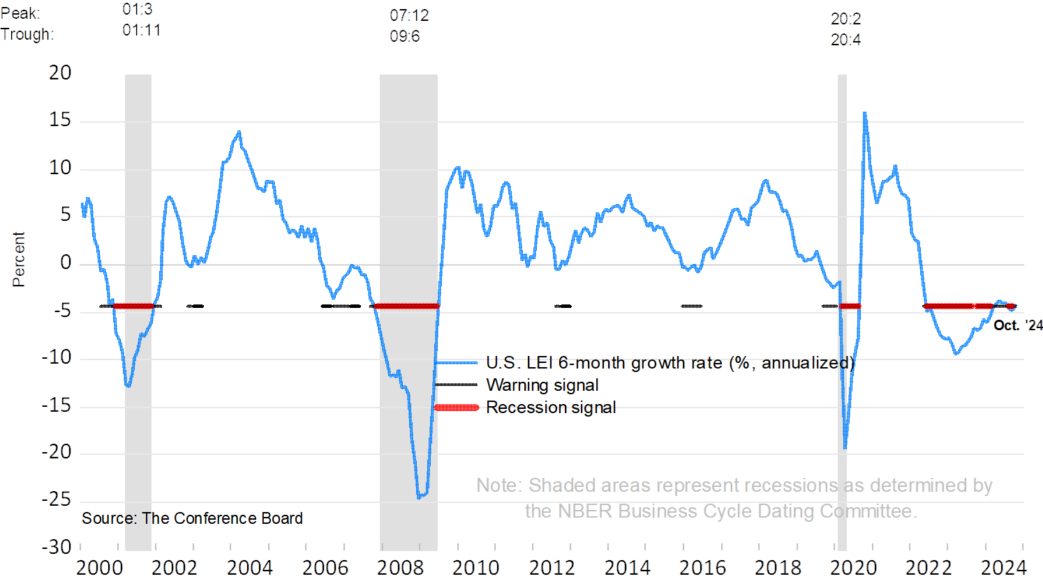
Recent: As of October 2024
2024
The Coincident Economic Index grew by .8% over the last six months. The components of the CEI are used to indicate recessions. This previous month yielded no change in the CEI, with positive factors being offset by negative industrial production.

Slide 20
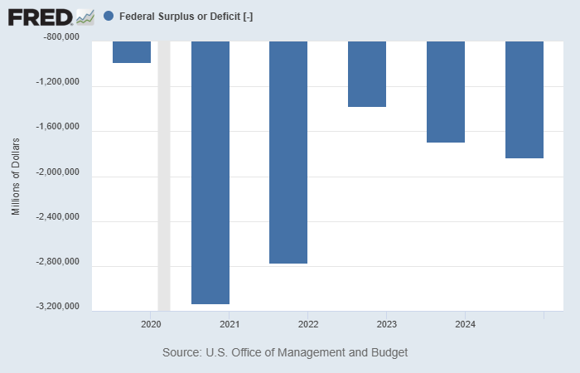
POLICY: Fiscal
Why deficit growing from 2022 - 2024? $1.8Trillion in 2024
2024
Revenue Growth Offset by Structural Spending
Tax revenues hit a record $4.9 trillion (+11%), boosted by corporate taxes (+26%) and postponed deadlines. However, spending growth, especially on interest and programs, continues to outpace revenue gains.
Rising Interest Payments and Debt Burden
Interest payments grew 34% to $950 billion in FY24 due to high interest rates and rising national debt. Now the 2nd largest expense after Social Security.
Increased Government Spending on Programs and Policies
Spending grew 10% to $6.8 trillion, driven by Social Security, Medicare, and tax credits. Potential student loan forgiveness could add $100+ billion to the deficit.
The decision to lower interest rates will help reduce debt costs, easing some pressure on the budget.
Notes:
https://fiscaldata.treasury.gov/americas-finance-guide/national-deficit/#:~:text=Fiscal%20year%2Dto%2Ddate%20(,has%20increased%20by%20%24244%20billion.
https://www.pgpf.org/programs-and-projects/fiscal-policy/current-debt-deficit/

Slide 21
David Gault, Sam Parent, Ali Zein, Arwa Abdulla, Amalia Jamaludin
2024
POLICY RECOMMENDATION
POLICY RECOMMENDATION

Slide 22
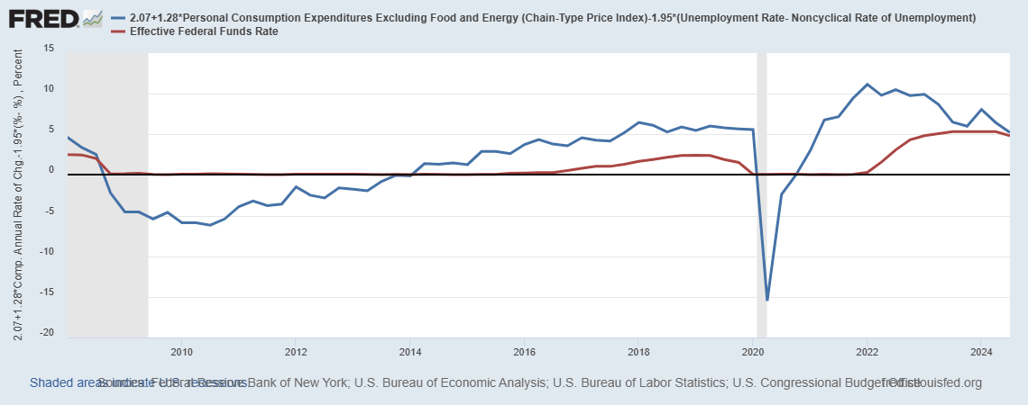
TAYLOR RULE INSIGHTS
2024
From the early 2000s to around 2018, the two rates tracked each other fairly closely.
However, since 2019, the actual EFFR has been considerably lower than the Taylor Rule prescribes but then at about same rate in recent data. (EFFR consistent with Taylor Rule)
The gap between the Taylor Rule FFR and the actual EFFR suggests monetary policy is less restrictive than prescribed. This reflects the focus on supporting the economy post-COVID-19 and aiding labor market recovery.
Latest: Our policy is closely aligned with the rule.
It suggests a neutral stance, balancing inflation control and economic growth.
Notes:
https://www.federalreserve.gov/monetarypolicy/fomc.htm#:~:text=The%20Federal%20Reserve%20controls%20the,discount%20rate%2C%20and%20reserve%20requirements.
https://www.federalreserve.gov/monetarypolicy/policytools.htm
The Federal Reserve uses various tools to implement monetary policy, influencing interest rates, credit availability, and overall economic stability:
Open Market Operations (OMO): Buying or selling government securities to control liquidity and influence the federal funds rate.
Discount Window: Providing short-term loans to banks at the Fed’s discount rate to support liquidity.
Reserve Requirements: Mandating minimum reserves banks must hold, impacting their lending capacity.
Interest on Reserve Balances (IORB): Paying interest on reserves held by banks, affecting their incentives to lend or hold funds.
Overnight Reverse Repurchase Agreement (ON RRP) Facility: Offering secure overnight investments to set a floor on short-term interest rates.
Term Deposit Facility (TDF): Allowing banks to place funds in time deposits with the Fed, reducing excess reserves.
Central Bank Liquidity Swaps: Providing dollar liquidity to foreign central banks to stabilize international markets.
Foreign and International Monetary Authorities (FIMA) Repo Facility: Offering dollar funding to foreign central banks through repurchase agreements.
Standing Overnight Repurchase Agreement (SORA) Facility: Supplying overnight liquidity to stabilize U.S. short-term funding markets.
Expired Policy Tools: Temporary programs like the Main Street Lending Program, Money Market Mutual Fund Liquidity Facility, and others designed for crisis response. These tools are inactive but can be reinstated during future disruptions.

Slide 23
SUMMARY
Where is the economy now?
Real GDP > Real Potential GDP
Unemployment < Natural Rate of Unemployment
Inflation above target
Debt is increasing
Interest Rate is decreasing
Global supply chain disruptions and geopolitical tensions are impacting the broader economy.
Where is it going?
Slower growth in 2025: High interest rates will likely lead to reduced consumer spending and slower business investment.
Inflation expected to decline gradually: While inflation is easing, it may take time to return to our 2% target.
What would happen if we did nothing?
Persistent inflation: If we doesn't act, inflation could stay high, eroding purchasing power.
Risk of stagnation or recession: Without action, inflation could escalate, potentially leading to a more severe economic downturn.
Long-term imbalances: Unchecked inflation could lead to asset bubbles and reduced investment, affecting long-term growth.

Slide 24
David Gault, Sam Parent, Ali Zein, Arwa Abdulla, Amalia Jamaludin
2024
WHAT WE WILL DO
Strategy : keep it tight but slowly easing monetary policy with gradual approach
Keeping the federal funds rate around 4.5% - 4.75% or take time to go back to normal rate allows the us to manage inflation without making abrupt changes to the economy. The rate affects borrowing costs for loans, mortgages, and savings. By maintaining the rate,we gives previous rate hikes time to work and help avoid overheating the economy. This strategy can help control inflation while preventing a sharp slowdown in growth. We can adjust its approach later based on inflation trends, ensuring it balances controlling inflation with supporting economic stability.
Maintaining the FFR
FORWARD GUIDANCE
Given inflation and economic uncertainty, we will avoid overly specific forward guidance. We will base decisions on the latest data, providing clarity on our policy direction without committing to specific outcomes. This flexible approach allows us to adapt to changing conditions, such as potential fiscal policies like import tariffs, which may impact GDP. Our focus is on the rationale behind our actions to maintain credibility and manage expectations.

Slide 25
David Gault, Sam Parent, Ali Zein, Arwa Abdulla, Amalia Jamaludin
2024
WHAT WE WILL DO
TOOLS
Interest on Reserve Balances
Action: Lower the interest rate on reserve balances to align with a broader strategy of easing monetary conditions to support economic growth.
Rationale: Lowering the rate on reserves encourages banks to lend more, helping stimulate economic activity and boosting liquidity in the economy. It also aligns with the Fed's goals of supporting spending and investment while gradually reducing inflation.
Overnight Reverse Repurchase Agreement Facility
Action: Continue to manage the ON RRP rate carefully, potentially lowering it in line with its general interest rate cuts.
Rationale: Lowering the ON RRP rate helps absorb excess reserves from the financial system while maintaining the target range for short-term rates. This facilitates smoother liquidity management and supports broader monetary policy objectives to promote credit flow and stabilize markets.
Notes:
https://apnews.com/article/federal-reserve-inflation-interest-rate-economy-7e0405851b6099278d491d0a938238f5 https://money.usnews.com/investing/news/articles/2024-12-06/feds-goolsbee-hopes-neutral-can-be-in-sight-by-late-next-year

Slide 26
In conclusion, our analysis of the economy's past, present, and projected future highlights key trends and the necessity for proactive action. The data and graphs presented illustrate a clear economic narrative: GDP is currently stabilizing at a moderate growth rate of 2.66% in Q3 2024. Despite a tight labor market, reflected in unemployment rates below the NAIRU and moderate wage growth, signs of softening have emerged. Inflation has cooled to 2.8% but remains above the 2% target, and high interest rates have successfully curbed its trajectory while creating recessionary risks.
Looking ahead, slower growth, lingering inflation, and rising debt necessitate careful policy implementation.
By adopting our proposed strategy of gradual monetary easing—balancing inflation control with economic stability—we can avoid stagnation while fostering sustainable growth. Lowering interest on reserve balances and maintaining forward guidance flexibility ensures liquidity, promotes investment, and avoids abrupt economic shocks. Our approach reflects lessons from past trends, aligns with current indicators, and proactively prepares for future challenges. Implementing this method is critical for steering the economy toward long-term stability and prosperity while mitigating risks of inaction.

